Slide 1
Model, World, View and Projection Matrix
Prepared by: Dipta J Gomes

Slide 2
Model View Projection
Model to World
World to View
View to Projection

Slide 3
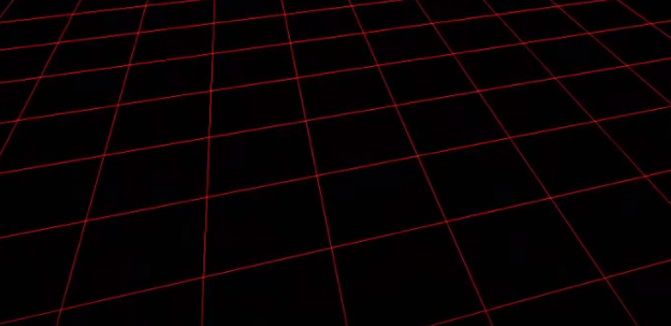
Model to World Matrix

Slide 4
Model to World Matrix

Slide 5
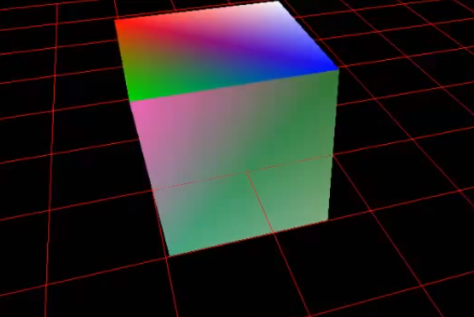
Object into world coordinate

Slide 6
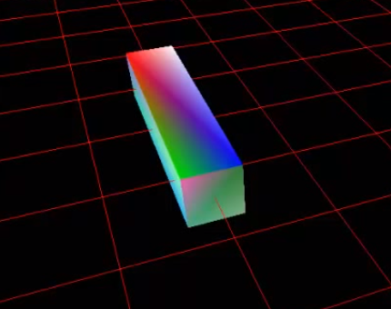
Alter the model (re-sizing)

Slide 7
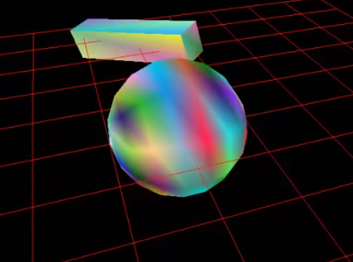
Create another object(Model to World)

Slide 8
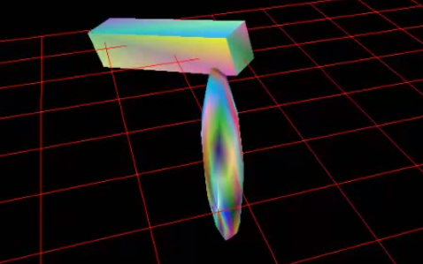
Re-sizing the Sphere

Slide 9
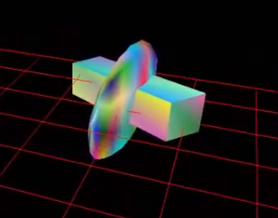
Put the two object like following:

Slide 10
World to View

Slide 11
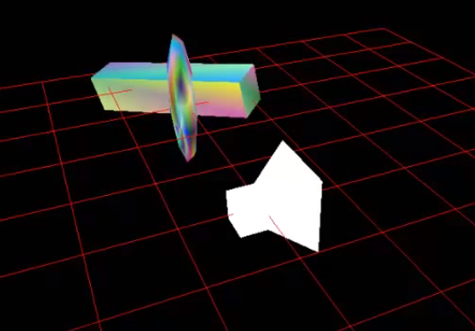
Added Camera in World Matrix

Slide 12
Added Camera in World Matrix

Slide 13

View from Camera

Slide 14
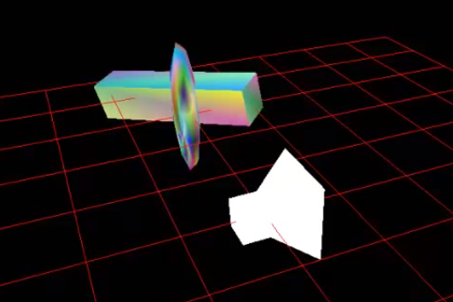
Solution?

Slide 15
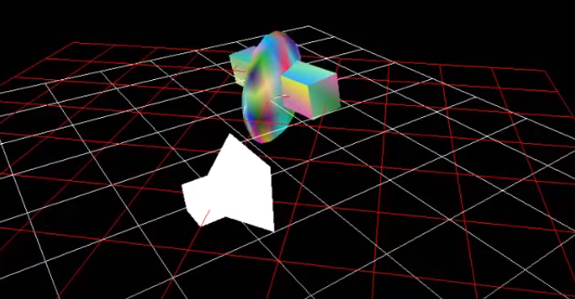
Transforming Object to Camera Position

Slide 16
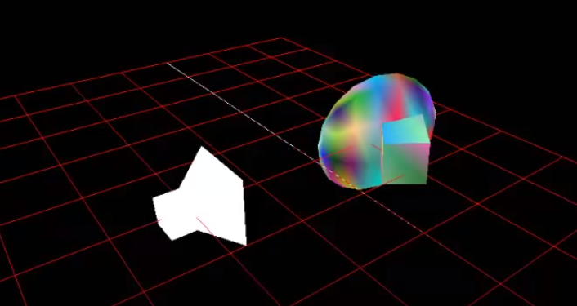
Brought Object on Camera

Slide 17
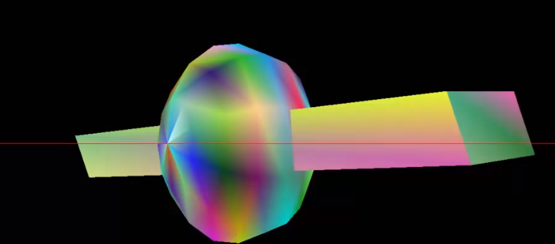
Object View from Camera

Slide 18
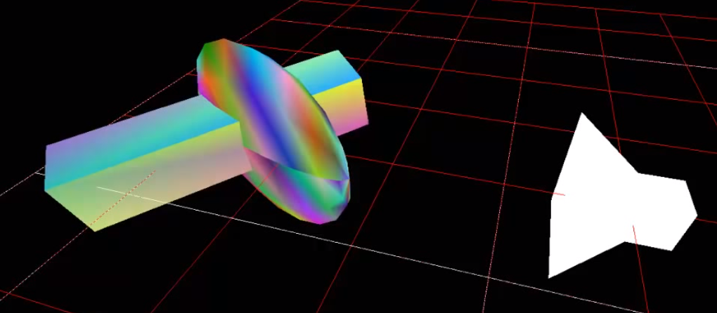
World Still 3D…

Slide 19
3D placed into 2D Space

Slide 20
Projection in Computer Graphics
Projection in computer graphics means the transformation of a three-dimensional (3D) area into a two-dimensional (2D) area.

Slide 21
3D World to 2D Space…(Projection Task)

Slide 22
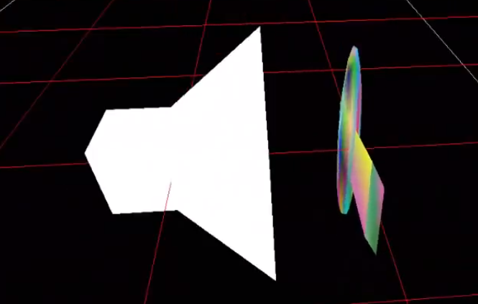
Projection

Slide 23
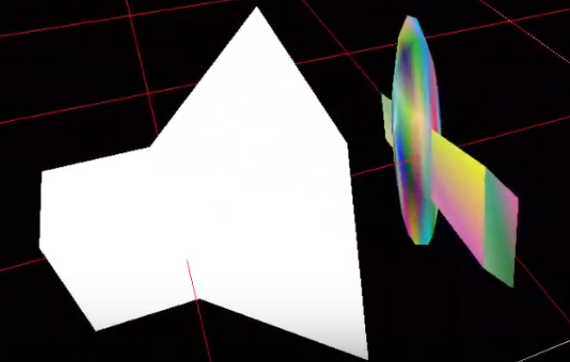
View to Projection

